Slide 1


Germany Rental Prediction
Urban Technology (WiSe2122)
Prof: Felix Bießmann

Slide 2

Table of Contents
Introduction
Dataset
Data Preparation
Data Visualization
Modeling
Evaluation

Slide 3
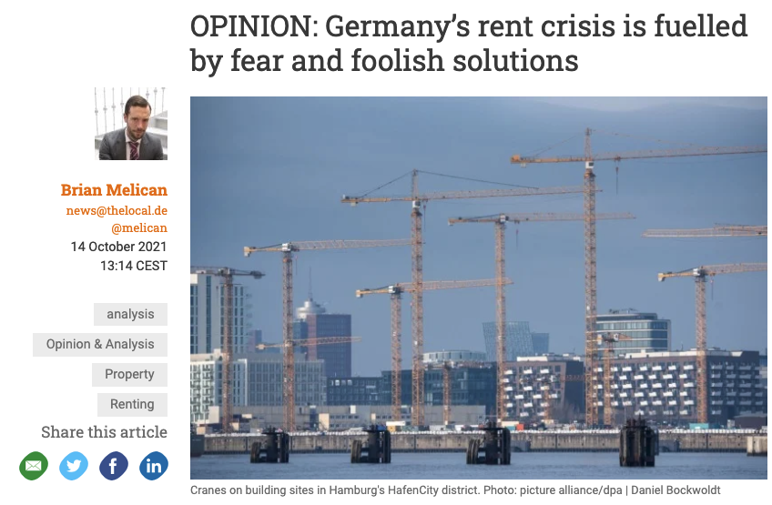


Introduction

Slide 4
Rent Crisis in Germay
Housing Crisis in germany is getting grave.
The country’s current government wants to create an entirely new ministry to oversee it.
Government pledge is to built 50,000 more units than the current goal.
Berlin tried to cap rents for five years, but court threw out the law earlier last year.
Germany has 1.8 million empty apartments, according to the DStGB, outside cities where people are less interested in living.
Population growth, bad decisions, slow construction, competing demands: These are just some of the causes of Germany's housing crisis

Slide 5
What to Expect
Data cleaning to clear the outliers and remove columns that doesn't have high correlation to the prediction
Create visualization to have a better understanding of the rental properties in Germany.
Try to Answer some pressing questions.
Feature engineering from the original variable to create a better model
Create a tool that estimate the house cost predicted by many variables
Compare those model to see the best results.

Slide 6
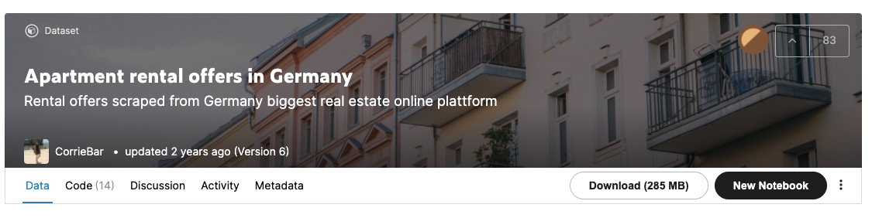
Dataset
The data is obtained from “Kaggle” for this project.
The data was scraped from Immoscout24.
The data set contains most of the important properties, such as living area size, the rent etc.
The dataset has 49 Columns and 268850 Rows.
Data could be found at https://www.kaggle.com/corrieaar/apartment-rental-offers-in-germany

Slide 7
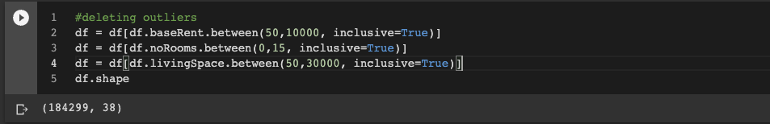
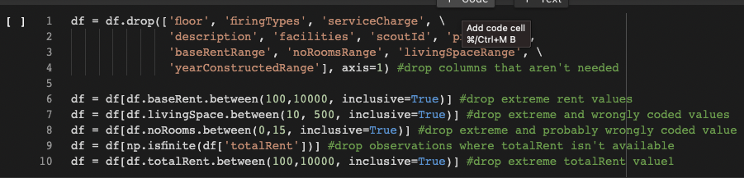
Data Cleaning
Dealing with Outliers:
Drop and Delete:

Slide 8
Data Analysis
Through viz we are trying to answer following questions:
Where it is higher base rent?
Property rent base on year of construction?
Expensive city as per average rent?
Average rent based on appartment condition?
In which city appartment are bigger in sizes?
What kind of heating impact appartment rent most?
What kind of appartment are expensive to rent?
In Berlin which distrcit is most expensive as per square meter?
In Berlin which district has higher no. of appartments?

Slide 9
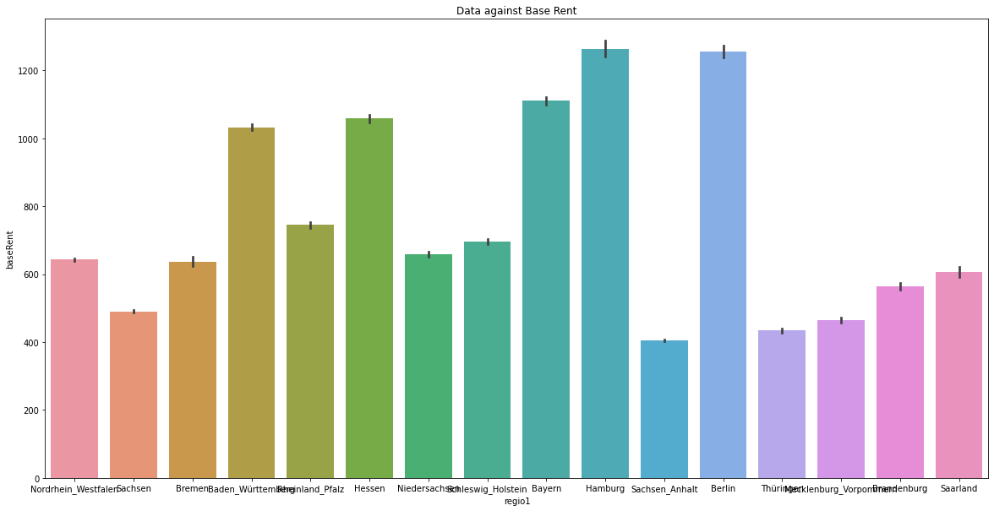
Data Visualization
Which city has highest base rent?

Slide 10
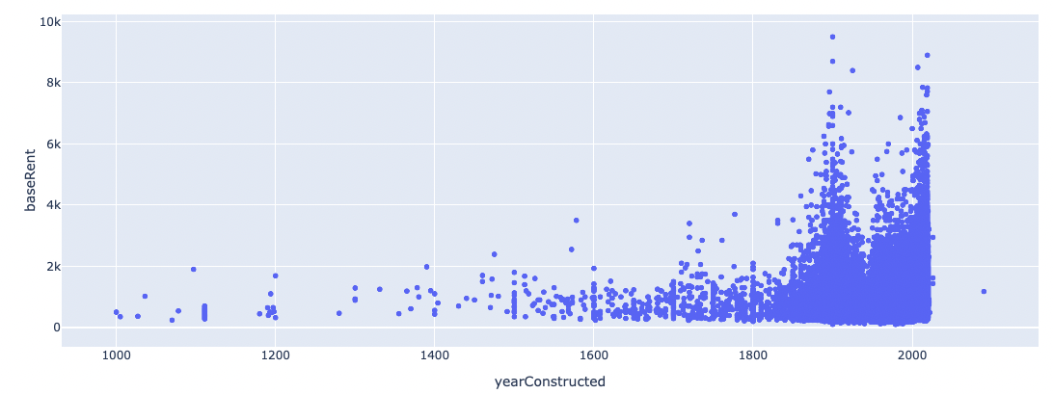
Data Visualization
Property rent base by year of construction?

Slide 11
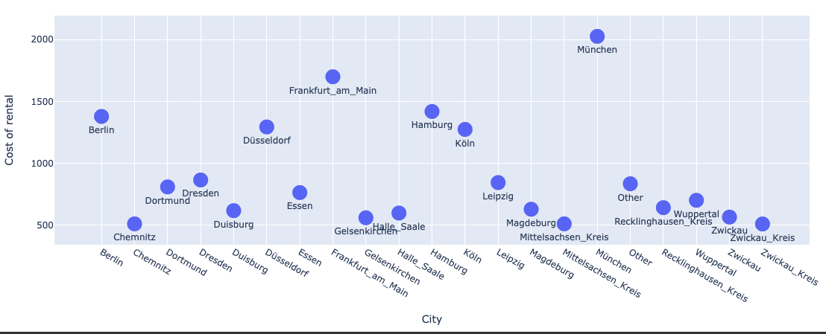
Data Visualization
Expensive city as per average rent?

Slide 12
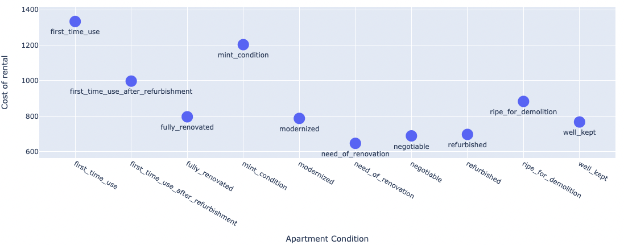
Data Visualization
Average rent based on appartment’s condition?

Slide 13
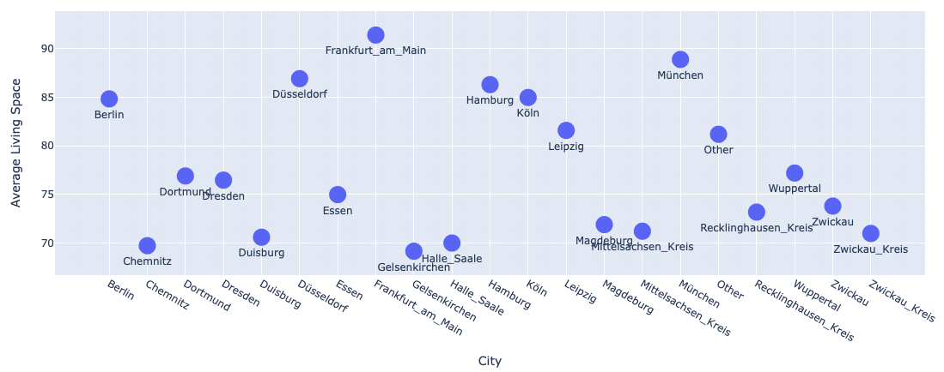
Data Visualization
In which city appartments are bigger in sizes?

Slide 14
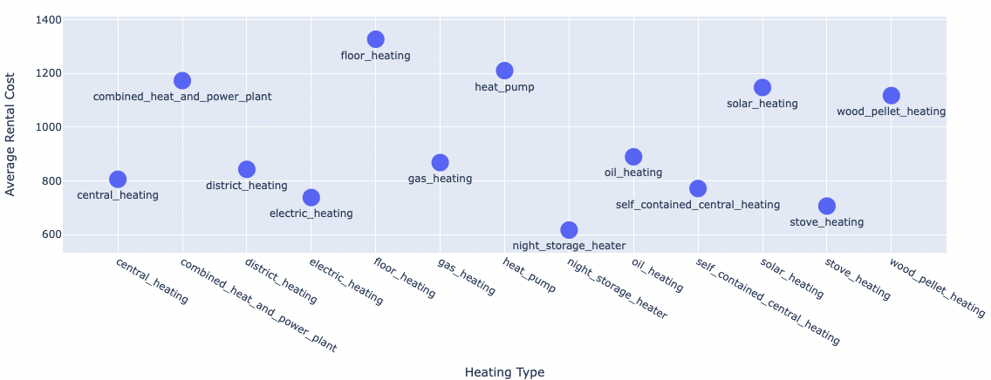
Data Visualization
What kind of heating impact appartment’s rent most?

Slide 15
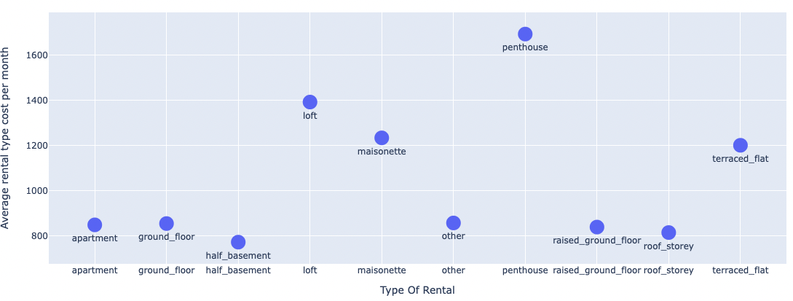
Data Visualization
What kind of appartments are expensive to rent?

Slide 16
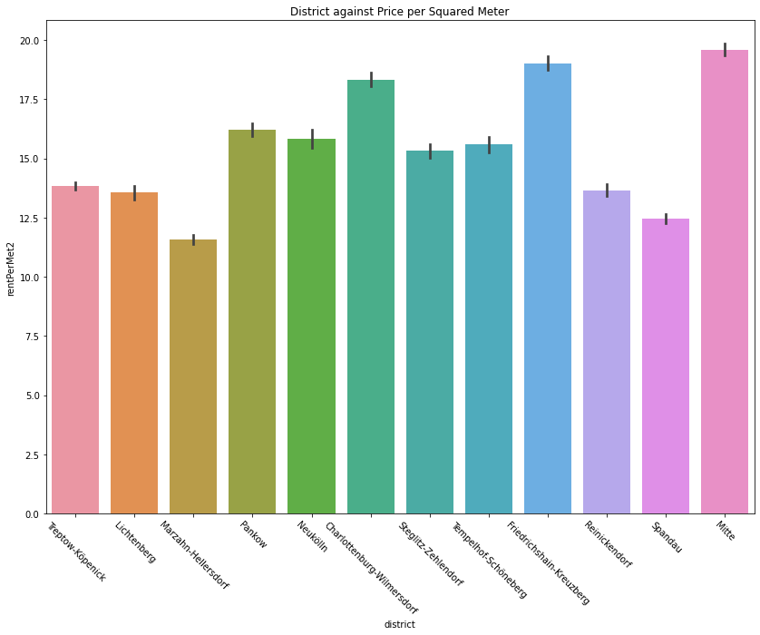
Data Visualization
In Berlin which distrcit is most expensive as per square meter?

Slide 17
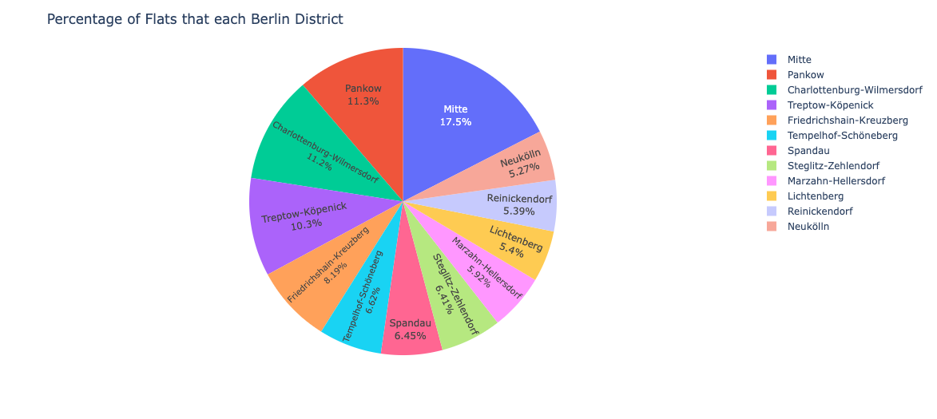
Data Visualization
In Berlin which district has higher no. of appartments?

Slide 18
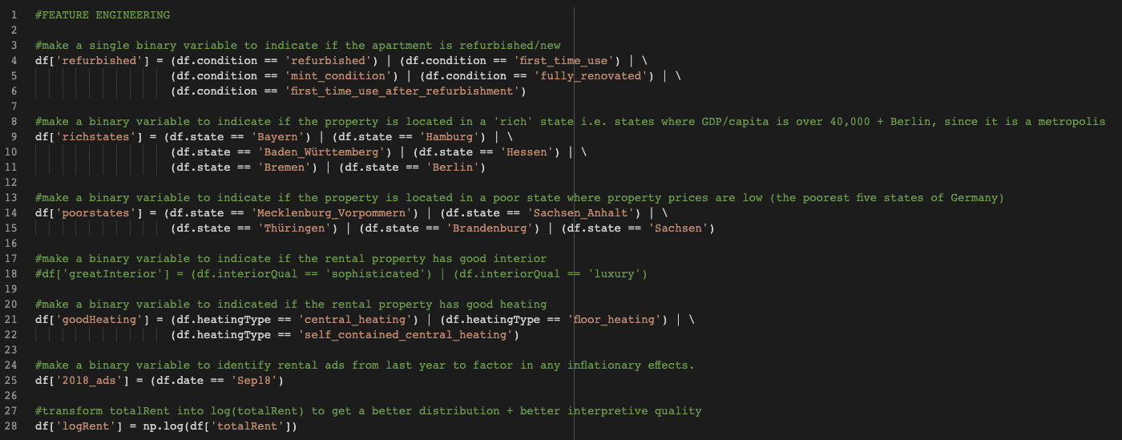
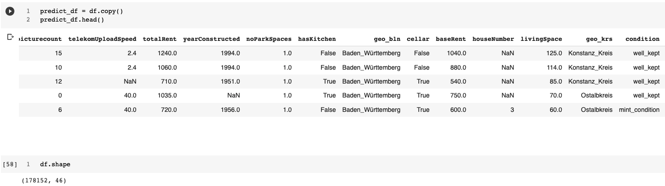
Feature Engeenring

Slide 19
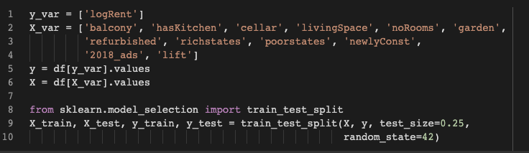
Train_Test_Split

Slide 20
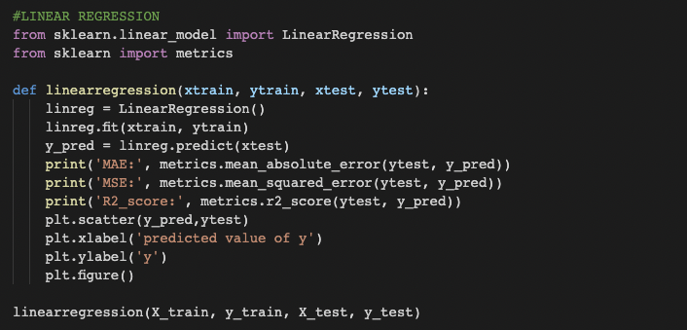
Linear Regression

Slide 21
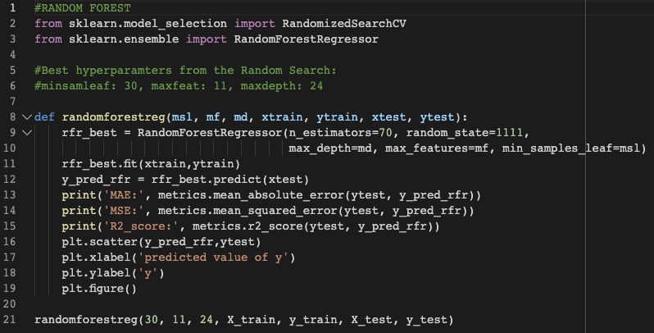
Random Forest

Slide 22
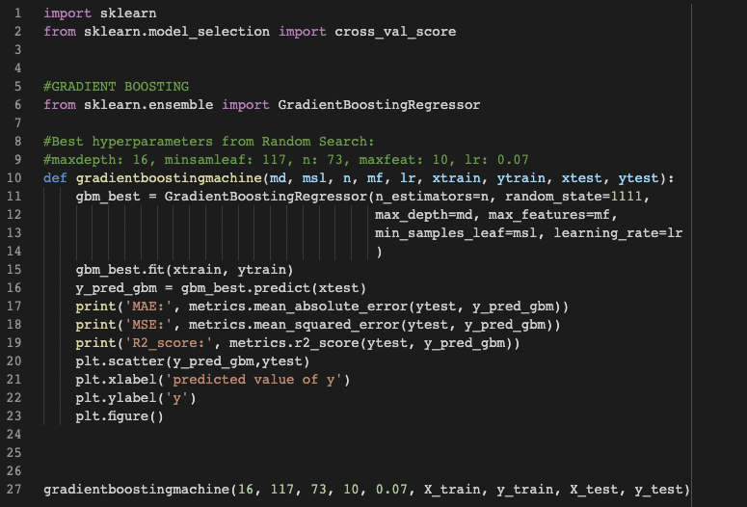
Gradient Boosting

Slide 23
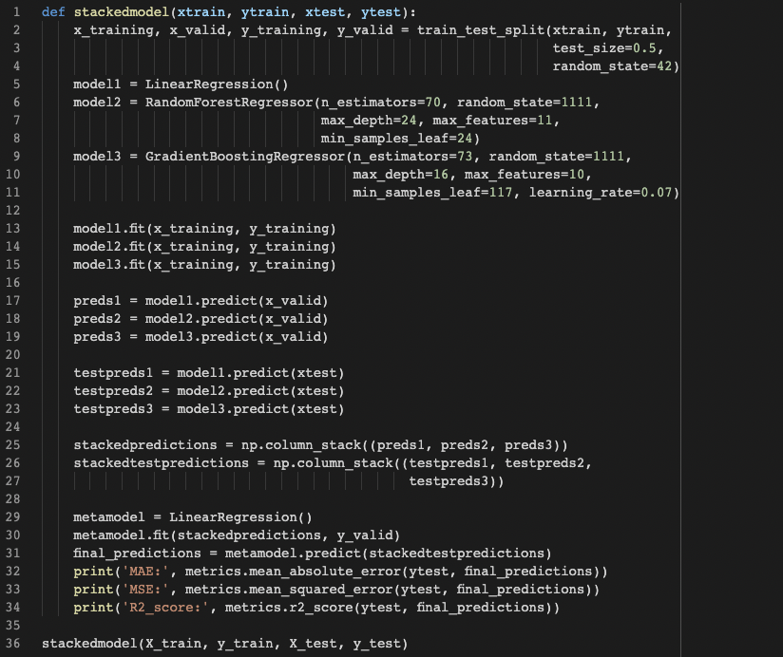
Stacked Model

Slide 24
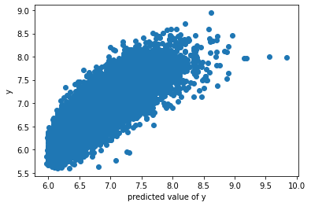
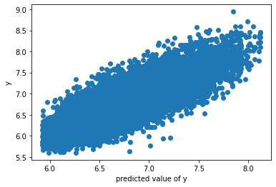
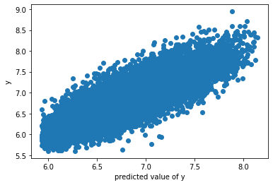
Model Evaluation
Model | Mean Absolute Error | Mean Squared Error | R2 Score
LINEAR REGRESSION | 0.17 | 0.05 | 0.77
RANDOM FOREST | 0.16 | 0.04 | 0.79
GRADIENT BOOSTING | 0.16 | 0.04 | 0.80
STACKED Model | 0.16 | 0.04 | 0.79
Linear Regression
Random Forest
Gradient Boosting

Slide 25


Slide 26
References
https://www.dw.com/en/fixing-germanys-housing-crisis-is-neither-quick-nor-easy/a-59515908
https://www.dw.com/en/germanys-next-government-aims-to-tackle-housing-crisis/a-59950132
https://www.thelocal.de/20211014/opinion-germanys-rent-crisis-is-fuelled-by-fear-and-foolish-solutions/
https://www.kaggle.com/

